Slide 1


PEMROGRAMAN WEB LANJUT

Slide 2
Setup Firebase Database
https://firebase.google.com/

Slide 3
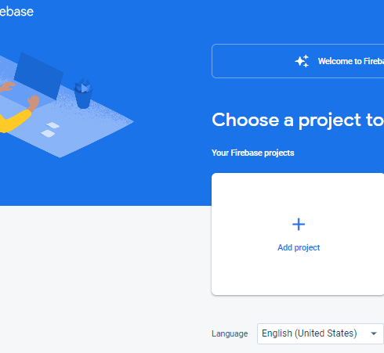
Produk > Build >realtime database>mulai
Klik Add Project

Slide 4
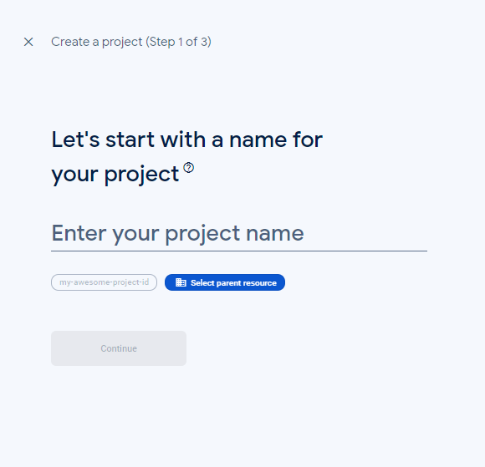
Masukkan nama proyek anda
Klik Continue

Slide 5

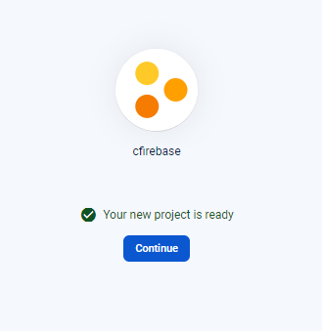
Klik Create Project, tunggu sampai muncul notif ‘Your new Project is ready’
Klik Continue
2
1

Slide 6
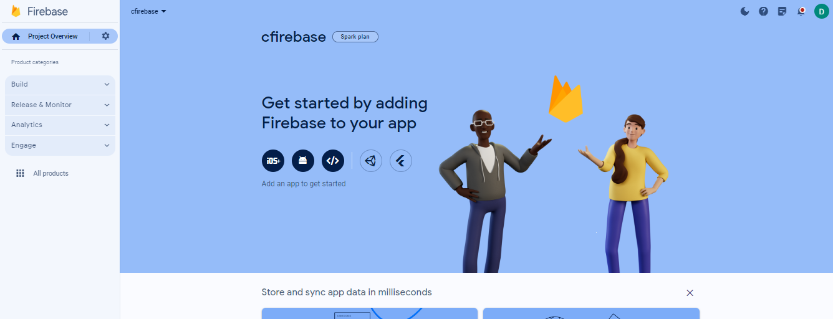
1
Klik Add an App bagian Web

Slide 7
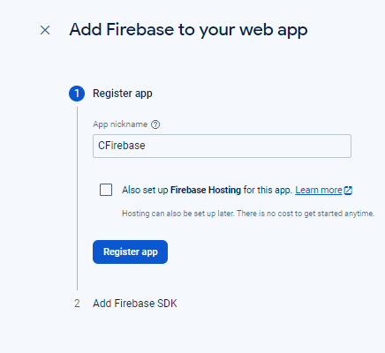
Isi App nickname, dan Klik register app

Slide 8
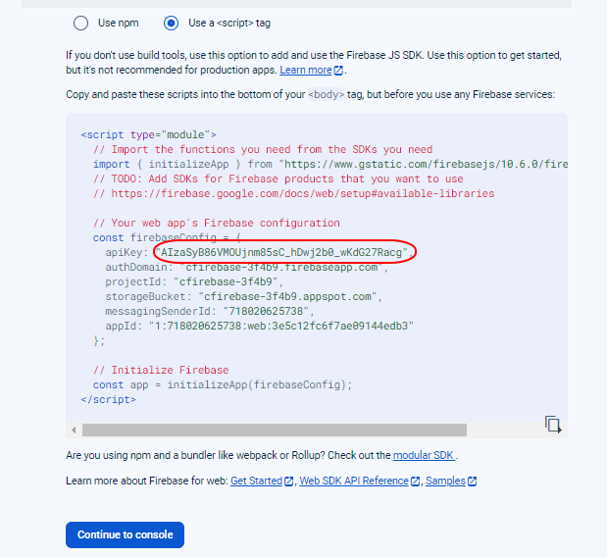
Simpan API Key proyek anda, dan klik Continue to console

Slide 9
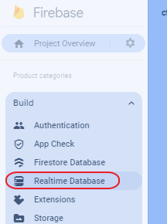
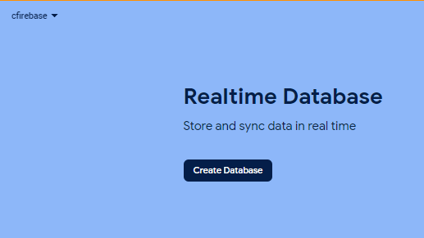
Klik Build -> Pilih Realtime Database.
Klik Create Database
1
2

Slide 10
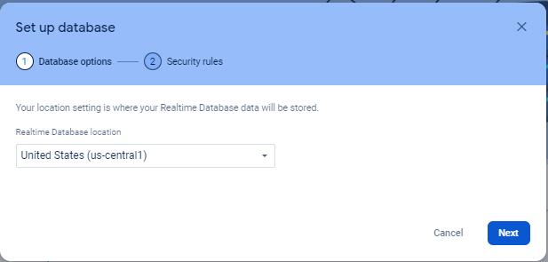
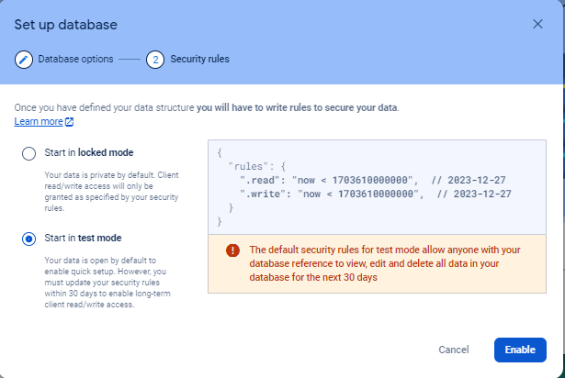
1
Klik Next
Pilih Start in test mode, dan klik Enable
2

Slide 11
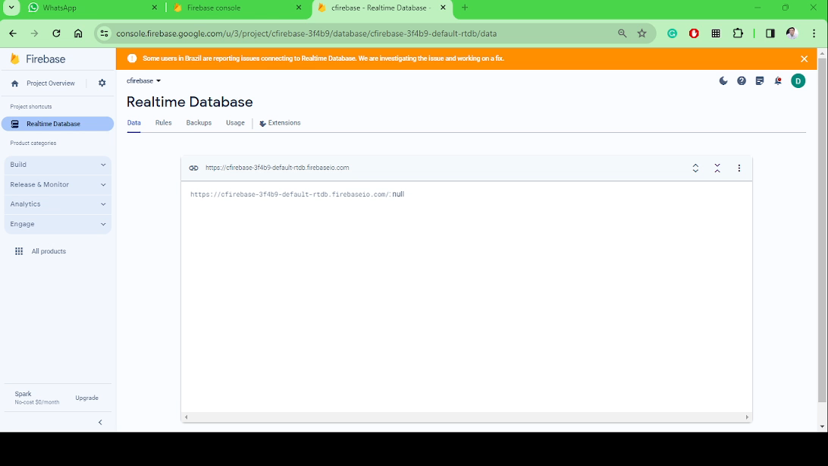
Pembuatan database

Slide 12
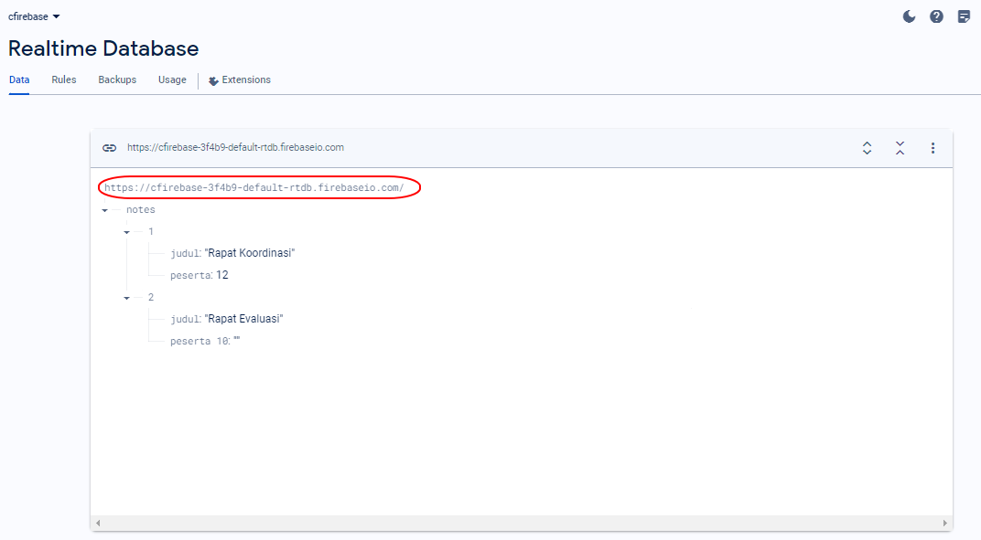
Alamat database

Slide 13
Setup codeigniter

Slide 14
Penambahan library firebase
Klik kanan git bash here pada xampp/htdocs lalu:
Buat ci4 dengan cara:
Klik kanan git bash here lalu:
Buka terminal di folder CI4, kemudian ketikkan:
Tekan enter
composer create-project codeigniter4/appstarter firebase_dessy
composer require eelkevdbos/firebase-php dev-master

Slide 15
Setting Controller
Buat file baru dan berinama dengan Confirebase.php, kemudian ketikkan syntax berikut
<?php
namespace App\Controllers;
use Firebase\Firebase;
class Confirebase extends BaseController
{
public function index()
{
$fb = Firebase::initialize('Alamat_database', 'API_key');
$a = $fb->get('/notes');
echo json_encode($a);
}
}

Slide 16
Tambahkan fungsi untuk Add, Update, dan Hapus
public function add_data()
{
$fb = Firebase::initialize('Alamat_database', 'API_key');
$d = [
"judul" => "Rapat Saja",
"peserta" => "5",
];
$a = $fb->push('/notes', $d);
echo json_encode($a);
}
public function update_data()
{
$key = $this->input->get("key");
$fb = Firebase::initialize('Alamat_database', 'API_key');
$d = [
"judul" => "Rapat Evaluasi 2",
"peserta" => "10",
];
$a = $fb->update('/notes/' . $key, $d);
echo json_encode($a);
}
public function delete_data()
{
$key = $this->input->get("key");
$fb = Firebase::initialize('Alamat_database', 'API_key');
$d = [
"judul" => "Rapat Evaluasi 2",
"peserta" => "10",
];
$a = $fb->delete('/notes/' . $key, $d);
echo json_encode($a);
}

